Slide 1

Why Poniek Labs Project Ali is good for you!
see website
© 2026 Poniek Labs Canada
https://labs.poniek.ca
https://github.com/Codebunny100/project-ali/

Slide 2
Ease of use
Poniek Labs Project Ali is our Classroom Sign out system. It is built to be efficient and easy to use. All teachers have to do is set it up and then students can enter their name, chose washroom, office, water, other and then click sign out. This will add them into the log and automatically enter the time. Then when the student returns and clicks sign back in it will record the sign in time and then calculate the time they were away. No other students can sign out while someone is signed out. This also eliminates the waste of paper and the time it takes teachers to print new sheets. Ali is designed with a Export to PDF button that exports the log to: you guessed it a PDF so the teachers can deliver the log to the office if needed. This works for IPAD, Android tablet, Chromebook, Macbook or any computer. Including Iphones and other smartphones.

Slide 3
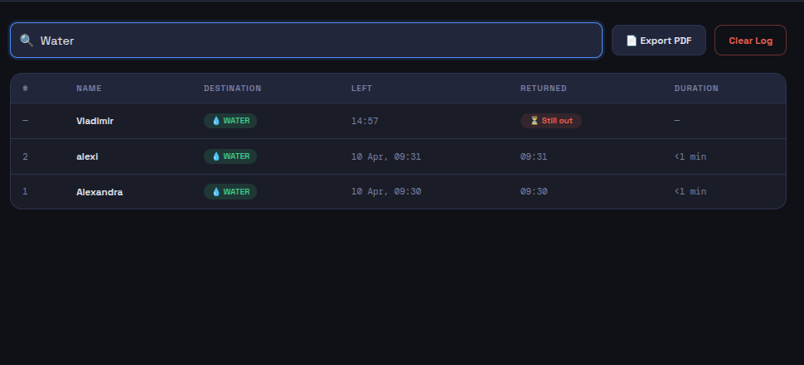

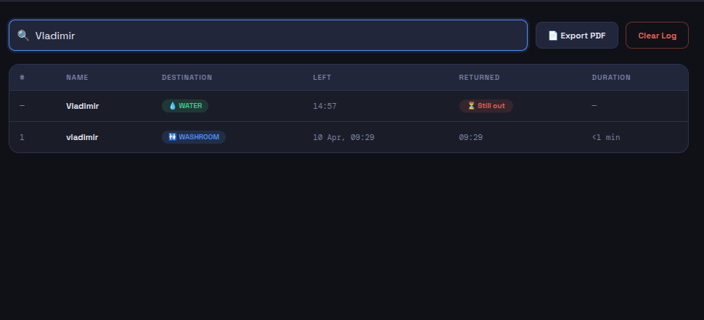
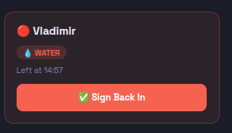
Reduction of waste
The Ali Sign out system doesn’t require any paper or marker! You just set it up, plug the computer in and it works.

Slide 4
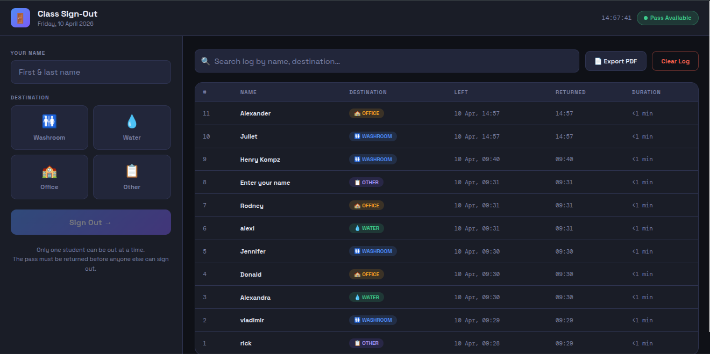

Slide 5
Setup
The Ali system works on all devices. To set up on chromebook: Download the html, click the html and open it in browser on: Mac, PC, Chromebook, Android or Click open with files on: Iphone or Ipad. Voila! It works
FYI: when you click export to pdf on ipad or iphone it will open up the pdf and you need to press the share button (the box with an arrow) and then save

Slide 6



Ali is made with:
And licensed under plSL-35 or the Poniek Labs Software License 35
See here: github.com/codebunny100/projectali/LICENSE

